Slide 1



Sales Data Management
Pizza Sales

Slide 2

Exploratory Data Analysis
Exploratory Data Analysis (EDA) is a crucial phase in the data analysis process that focuses on understanding the main characteristics of a dataset
Key Objectives:
Understanding Characteristics: EDA aids in comprehending data characteristics, such as patterns, trends, outliers, and relationships.
Informing Subsequent Analyses: The insights gained from EDA set the stage for more advanced analyses and modeling.
Techniques Employed:
Visual Exploration: Utilizing graphs and charts to visually represent data distributions and relationships.
Statistical Summaries: Calculating summary statistics to provide a quantitative overview of the data.
Significance:
Challenges Identification: EDA helps identify challenges like missing values or outliers, allowing for informed decision-making in subsequent analyses.

Slide 3
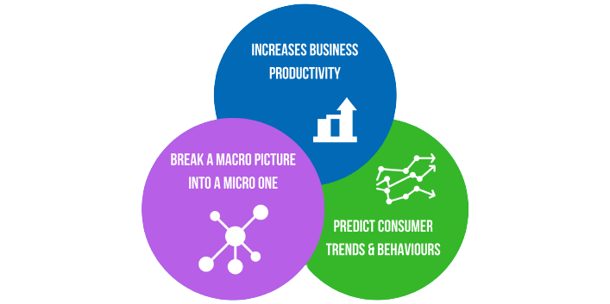
Importance of Data Analysis
Informed Decision-Making
Identifying Trends and Patterns
Optimizing Operations
Risk Management
Customer Insights
Performance Measurement
Competitive Advantage

Slide 4

Purpose
The primary purpose of this Exploratory Data Analysis (EDA) project is to gain valuable insights into the pizza sales data, understand customer preferences, and identify trends that can inform business strategies. Through data exploration, we aim to uncover patterns, anomalies, and meaningful correlations that can drive decision-making within the pizza business.

Slide 5

Aim of the project
The primary aim of this project is to provide actionable insights to enhance business decision-making. By analyzing the pizza sales data, we aim to:
Optimize marketing strategies based on popular pizza categories and sizes.
Improve inventory management by understanding demand patterns.
Identify underperforming pizzas and explore opportunities for menu optimization.
Enhance customer satisfaction by aligning offerings with preferences.

Slide 6

Optimizing Marketing Strategies
Objective:
Optimize marketing strategies based on insights derived from the analysis of popular pizza categories and sizes.
Approach:
Analyze sales data to identify the most popular pizza categories and sizes among customers.
Utilize visualization tools to create charts illustrating the distribution of sales across different categories and sizes.
Insights:
Identify top-selling pizza categories and sizes to focus marketing efforts on high-demand products.
Tailor promotional campaigns to highlight customer-favorite categories, potentially introducing promotions or bundles.

Slide 7


Improving Inventory Management
Objective:
Improve inventory management by understanding and leveraging demand patterns.
Approach:
Analyze historical data to identify trends and fluctuations in pizza orders over time.
Utilize visualizations to illustrate hourly and weekly trends in total orders.
Insights:
Forecast peak demand periods to optimize inventory levels and prevent stockouts.
Implement dynamic inventory adjustments based on hourly and weekly variations in demand.

Slide 8

Identifying Underperforming Pizzas
Objective:
Identify underperforming pizzas and explore opportunities for menu optimization.
Approach:
Analyze sales data to identify pizzas with lower revenue, quantity, and order numbers.
Use visualizations to compare the performance of different pizzas.
Insights:
Pinpoint underperforming pizzas and assess potential reasons for low sales.
Explore modifications, such as ingredient adjustments or marketing strategies, to enhance the appeal of underperforming pizzas.

Slide 9

Enhancing Customer Satisfaction
Objective:
Enhance customer satisfaction by aligning offerings with customer preferences.
Approach:
Analyze data on customer preferences, as indicated by the popularity of specific pizza categories and sizes.
Utilize customer feedback and order data to tailor offerings to customer preferences.
Insights:
Identify and prioritize customer-favorite pizza options.
Implement changes to the menu based on customer feedback and preferences to improve overall satisfaction.

Slide 10

Processing Involved in our Analysis
The EDA process involves several key steps:
Data Cleaning: Ensuring data accuracy by handling missing values, duplicates, and outliers.
Descriptive Statistics: Calculating key metrics like mean, median, and standard deviation to understand the central tendency and variability in the data.
Visualization: Using charts and graphs to visually represent trends, distributions, and relationships in the data.
Trend Analysis: Identifying patterns and trends over time, such as hourly and weekly variations in orders.
Category Analysis: Exploring the distribution of sales across different pizza categories and sizes.
Top/Bottom Performers: Identifying the best and worst-selling pizzas based on revenue, quantity, and orders.

Slide 11
Overview of Pizza Sales Data
Dataset Composition:
The dataset contains detailed information about pizza orders, including order ID, pizza name, quantity, order date, order time, unit price, total price, pizza size, pizza category, pizza ingredients, and pizza name ID.
Time Period:
The dataset spans a significant time period, capturing a diverse range of customer behaviors and preferences.
Data Structure:
Structured data with clear columns and relationships, enabling effective analysis and interpretation.

Slide 12

Tools used
Excel: Used for data cleaning, basic analysis, and initial exploration.
SQL: Leveraged for querying and extracting relevant data from the database.
Tableau: Employed for creating interactive and insightful visualizations for in-depth analysis

Slide 13
KPI’s
Total Revenue: The sum of the total price of all pizza orders.
Average Order Value: The average amount spent per order, calculated by dividing the total revenue by the total number of orders.
Total Pizzas Sold: The sum of the quantities of all pizzas sold.
Total Orders: The total number of orders placed.
Average Pizzas Per Order: The average number of pizzas sold per order, calculated by dividing the total number of pizzas sold by the total number of orders.

Slide 14
Problem Statements
Hourly Trend for Total Pizzas Sold:
Generate a stacked bar chart depicting the hourly trend of total orders over a specific time period.
This visualization will assist in uncovering patterns and fluctuations in order volumes on an hourly basis, enabling a detailed understanding of peak and low-demand periods.
Weekly Trend for Total Orders:
Construct a line chart showcasing the weekly trend of total orders throughout the year.
This graphical representation will facilitate the identification of peak weeks or periods of heightened order activity, allowing for strategic planning and resource allocation.
Percentage of Sales by Pizza Category:
Develop a pie chart that visually represents the distribution of sales across various pizza categories.
This chart will offer valuable insights into the popularity of different pizza categories and their respective contributions to the overall sales, aiding in strategic decision-making and menu optimization.

Slide 15
Problem Statements
Percentage of Sales by Pizza Size:
Develop a pie chart illustrating the distribution of sales across different pizza sizes.
This visual representation will provide insights into customer preferences for pizza sizes, aiding in a comprehensive understanding of their impact on overall sales.
Total Pizzas Sold by Pizza Category:
Construct a funnel chart to present the total number of pizzas sold for each pizza category.
This chart will facilitate a comparative analysis of the sales performance of different pizza categories, offering valuable insights for strategic decision-making.

Slide 16
Problem Statements
Top 5 Best Sellers by Revenue, Total Quantity, and Total Orders:
Create a bar chart that highlights the top 5 best-selling pizzas based on revenue, total quantity, and total orders.
This chart will serve as a valuable tool to identify and analyze the most popular pizza options, informing marketing strategies and inventory management.
Bottom 5 Best Sellers by Revenue, Total Quantity, and Total Orders:
Develop a bar chart showcasing the bottom 5 worst-selling pizzas based on revenue, total quantity, and total orders.
This chart will assist in pinpointing underperforming or less popular pizza options, guiding decisions on potential menu adjustments and marketing efforts.

Slide 17

SQL analysis
Slide 18-30

Slide 18

KPI’s (Query through Analysis)
1.Total Revenue: The sum of the total price of all pizza orders.
SQL Query: select sum(total_price) as Total_Revenue from pizza_sales;
2.Average Order Value: The average amount spent per order, calculated by dividing the total revenue by the total number of orders.
SQL Query: select sum(total_price)/count(distinct order_id) as Average_ord_value from pizza_sales;

Slide 19


KPI’s (Query through Analysis)
3.Total Pizzas Sold: The sum of the quantities of all pizzas sold.
SQL Query: Select sum(quantity) as Total_Pizza_sold from pizza_sales
4.Total Orders: The total number of orders placed.
SQL Query: select count(distinct order_id) as Total_orders from pizza_sales

Slide 20

KPI’s (Query through Analysis)
5.Average Pizzas Per Order: The average number of pizzas sold per order, calculated by dividing the total number of pizzas sold by the total number of orders.
SQL Query:
select Cast (sum(quantity) as decimal(10,2)) /cast (count(distinct order_id) as decimal(10,2)) as Average_orders from pizza_sales

Slide 21
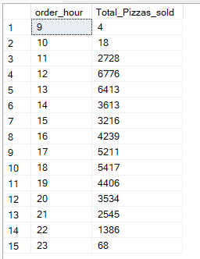
Hourly Trend for total Pizzas sold (Query through Analysis)
SQL Query:
Select DATEPART(Hour,order_time) as order_hour, sum(quantity) as Total_Pizzas_sold
from pizza_sales
Group by DATEPART(Hour,order_time)
order by DATEPART(Hour,order_time) ASC;

Slide 22
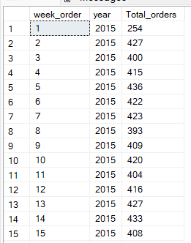
Weekly Trend for Total orders (Query through Analysis)
SQL Query:
Select DATEPART(ISO_Week, Order_date) as week_order,Year(order_date) as year, count(distinct order_id) as Total_orders from pizza_sales
group by DATEPART(ISO_Week, Order_date),Year(order_date)
order by DATEPART(ISO_Week, Order_date), Year(order_date)

Slide 23
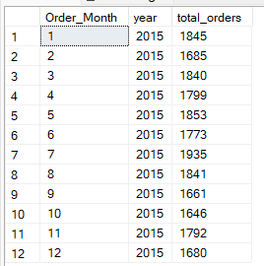
Monthly Trend for Total order (Query through Analysis)
SQL Query:
Select DATEPART(Month,order_date) as Order_Month, year(order_date) as year, count(Distinct order_id) As total_orders
from pizza_sales
group by DATEPART(Month,order_date), year(order_date)
order by DATEPART(Month,order_date), year(order_date) Asc;

Slide 24
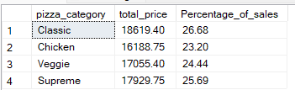
Percentage of sales by Pizza Category for first month (Query through Analysis)
SQL Query:
select pizza_category,cast(sum(total_price) as decimal (10,2)) as total_price, cast(sum(total_price)*100/(select sum(total_price) from pizza_sales Where month(order_date)=1) as decimal(10,2)) as Percentage_of_sales
from pizza_sales
Where month(order_date)=1
group by pizza_category;

Slide 25
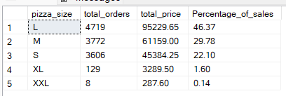
Percentage of sales by Pizza Size - first quarter (Query through Analysis)
SQL Query:
select pizza_size, count(pizza_size) as total_orders, cast(sum(total_price) as decimal (10,2)) as total_price, cast(sum(total_price)*100/(select sum(total_price) from pizza_sales Where datepart(quarter,order_date)=1) as decimal(10,2)) as Percentage_of_sales
from pizza_sales
where datepart(quarter,order_date)=1
group by pizza_size
order by Percentage_of_sales desc;

Slide 26
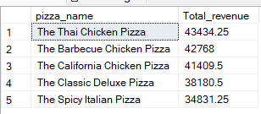
Top 5 selling Pizza Name -price (Query through Analysis)
SQL Query:
select top 5 pizza_name, sum(total_price) as Total_revenue
from pizza_sales
group by pizza_name
order by Total_revenue Desc;

Slide 27
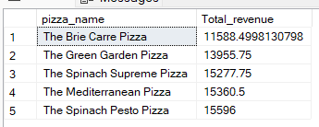
Bottom 5 selling Pizza Name - price (Query through Analysis)
SQL Query:
select top 5 pizza_name, sum(total_price) as Total_revenue
from pizza_sales
group by pizza_name
order by Total_revenue Asc;

Slide 28
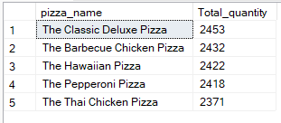
Top 5 selling Pizza Name - quantity (Query through Analysis)
SQL Query:
select top 5 pizza_name, sum(quantity) as Total_quantity
from pizza_sales
group by pizza_name
order by Total_quantity Desc;

Slide 29
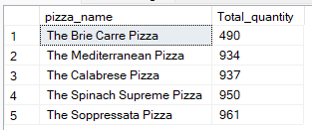
Bottom 5 selling Pizza Name - quantity (Query through Analysis)
SQL Query:
select top 5 pizza_name, sum(quantity) as Total_quantity
from pizza_sales
group by pizza_name
order by Total_quantity Asc;

Slide 30
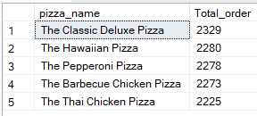
Top 5 selling Pizza Name - order_id (Query through Analysis)
SQL Query:
select top 5 pizza_name, count(distinct order_id) as Total_order
from pizza_sales
group by pizza_name
order by Total_order Desc;

Slide 31

Tableau Visualization
Slide 32-50

Slide 32
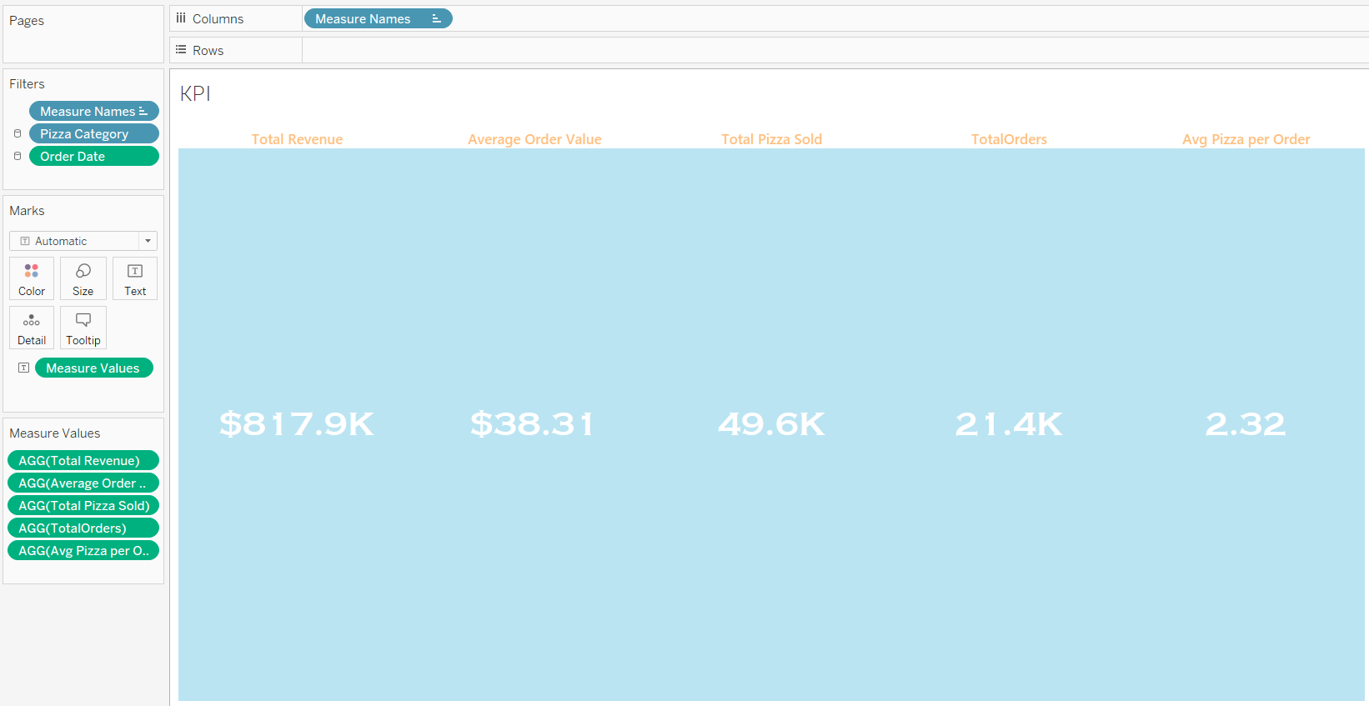
KPI’s

Slide 33
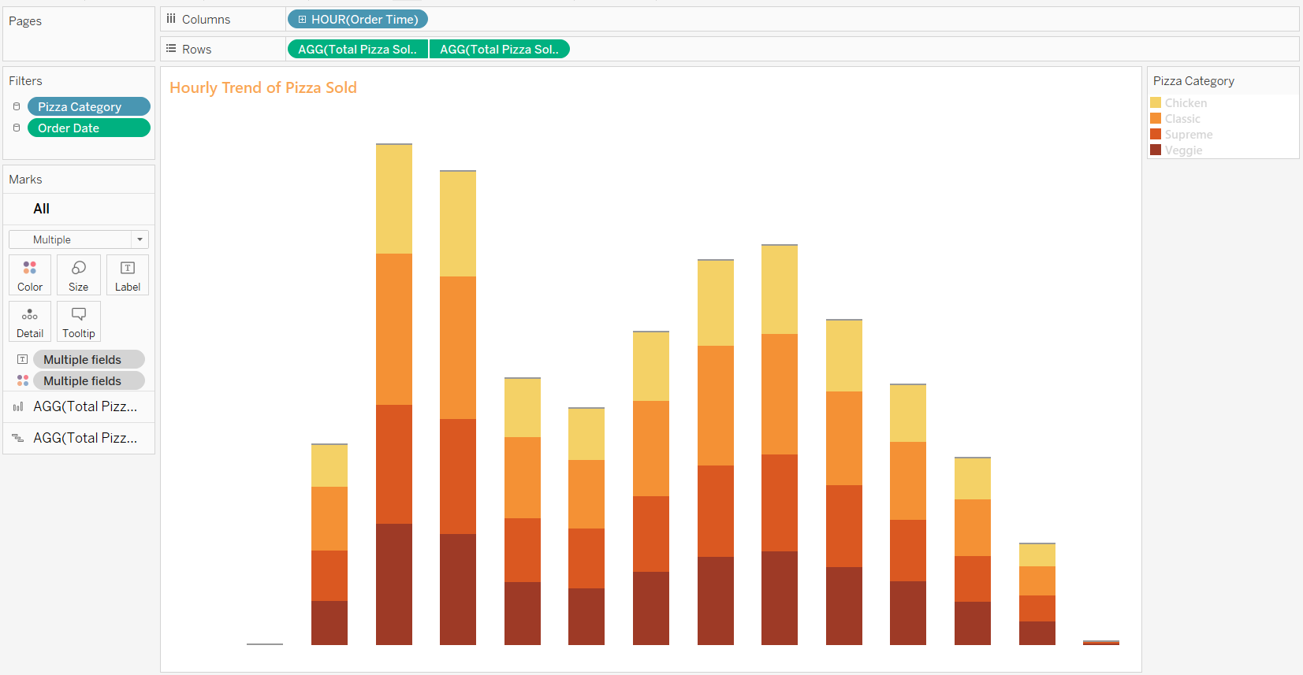
Hourly Trend of Pizza Sold

Slide 34
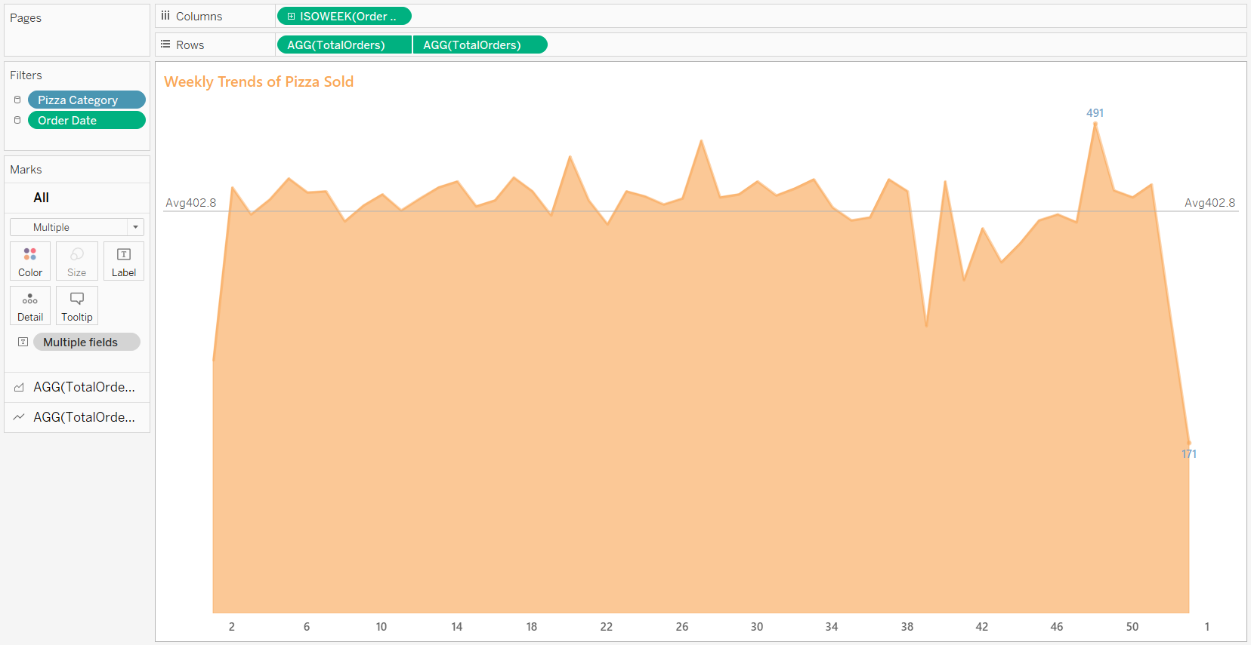
Weekly Trend of Pizza Sold

Slide 35
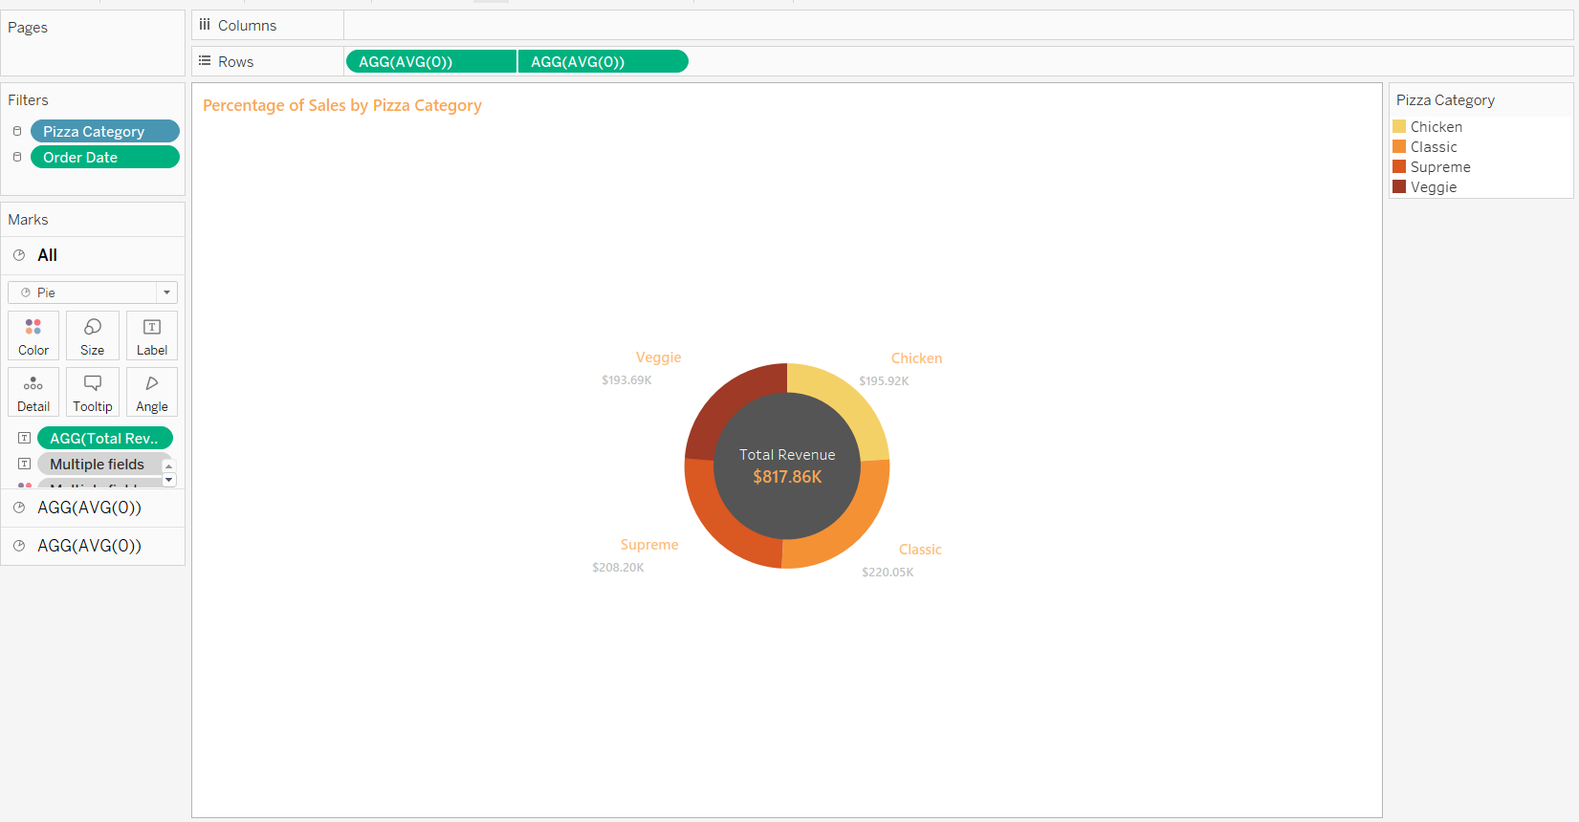
Percentage of sales by category

Slide 36
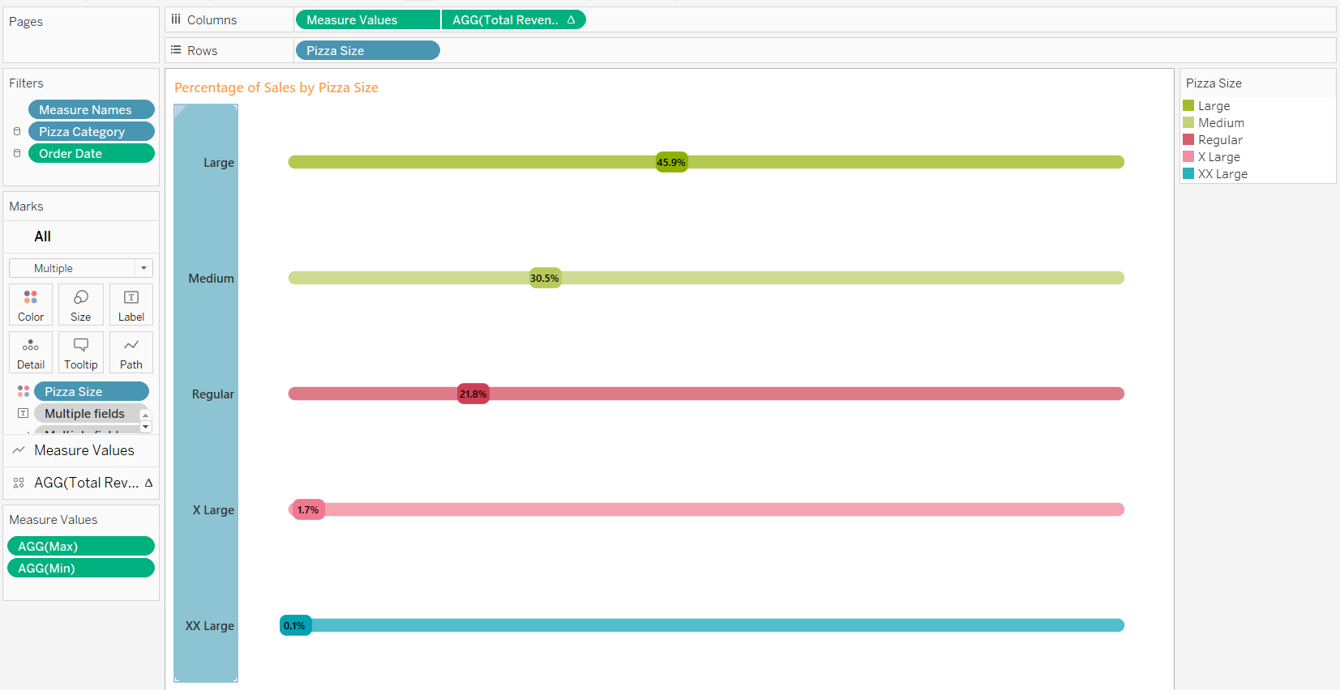
Percentage of sales by Size

Slide 37
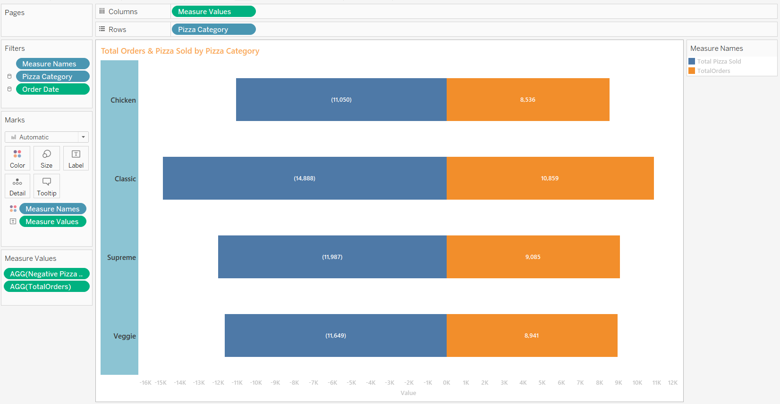
Total orders & Pizza Sold by Pizza Category

Slide 38
Total orders & Pizza Sold by Pizza Category

Slide 39
Total orders & Pizza Sold by Pizza Category

Slide 40
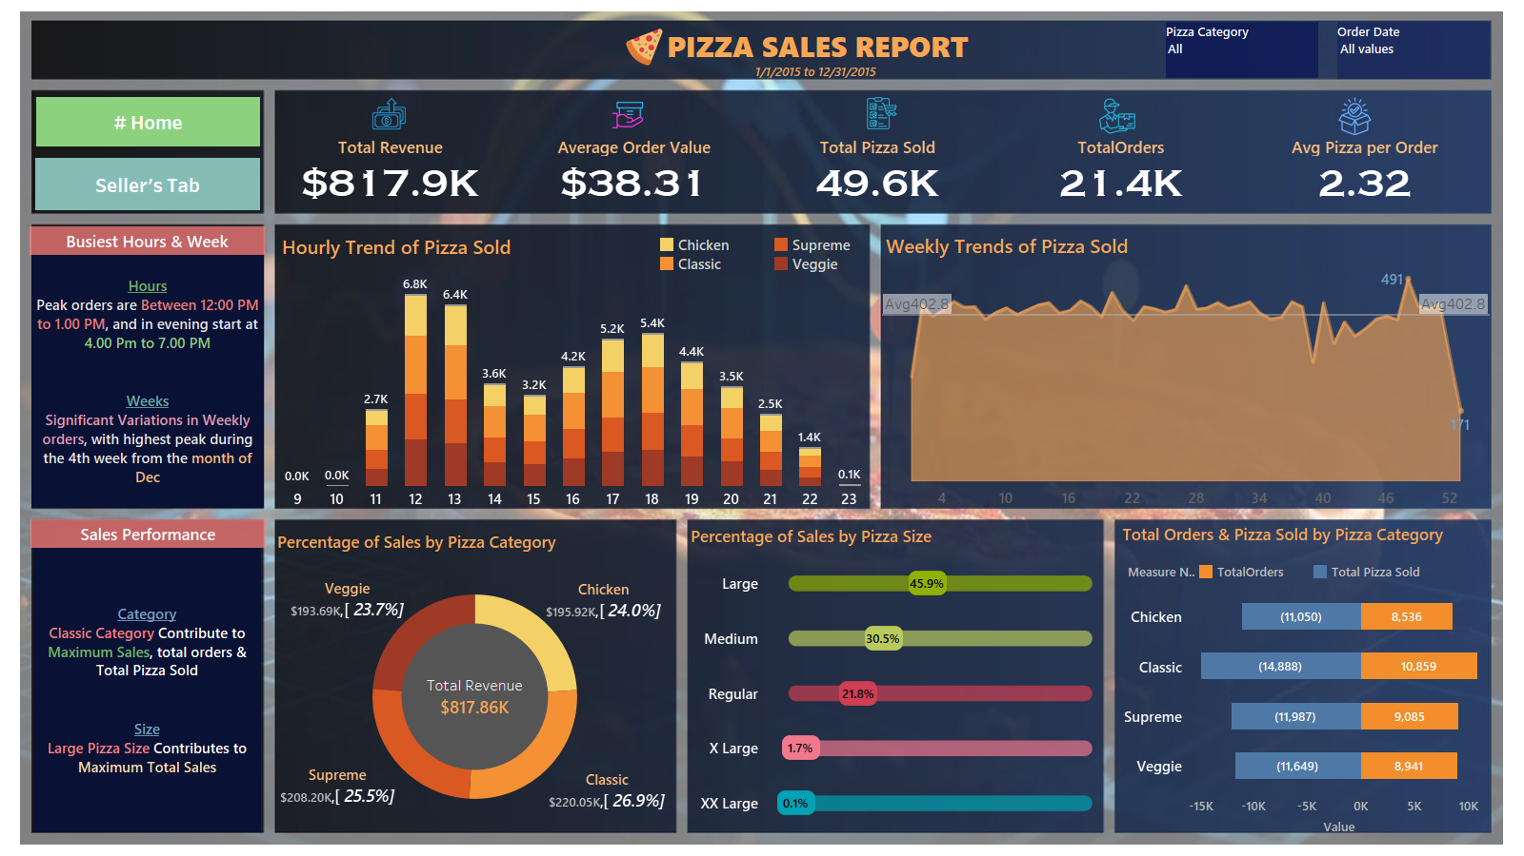
Final Output

Slide 41
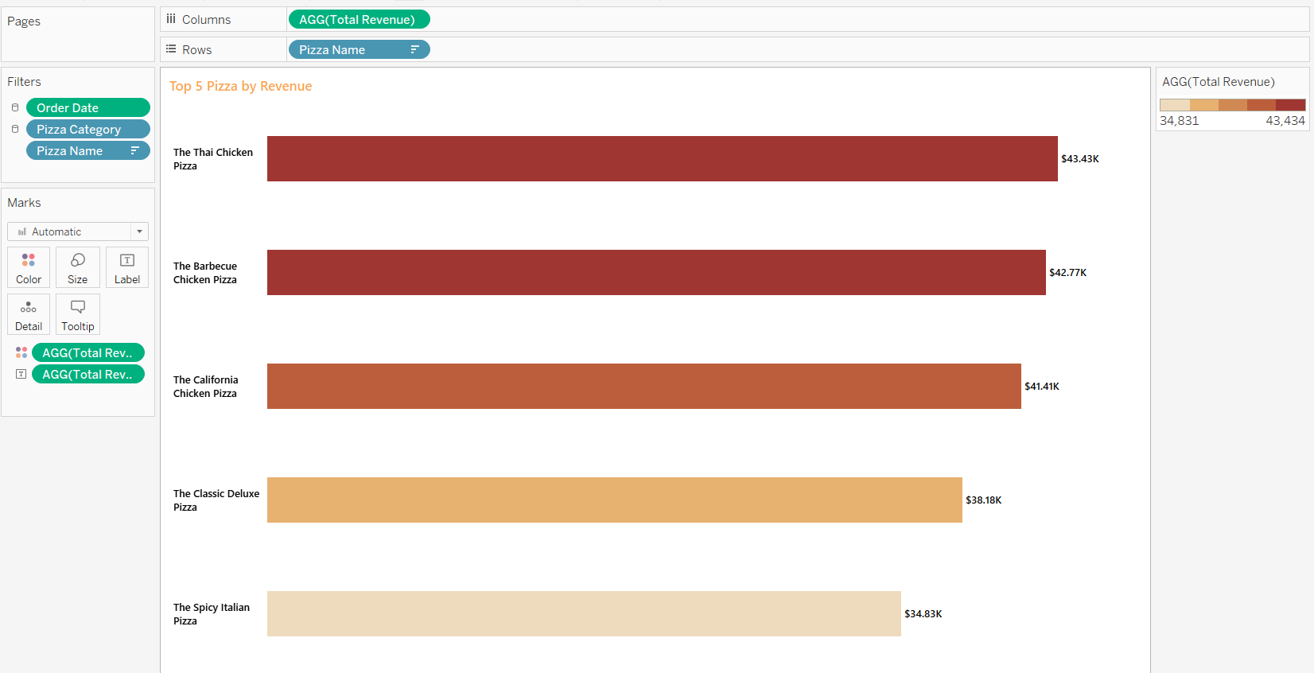
Top 5 pizza by revenue

Slide 42
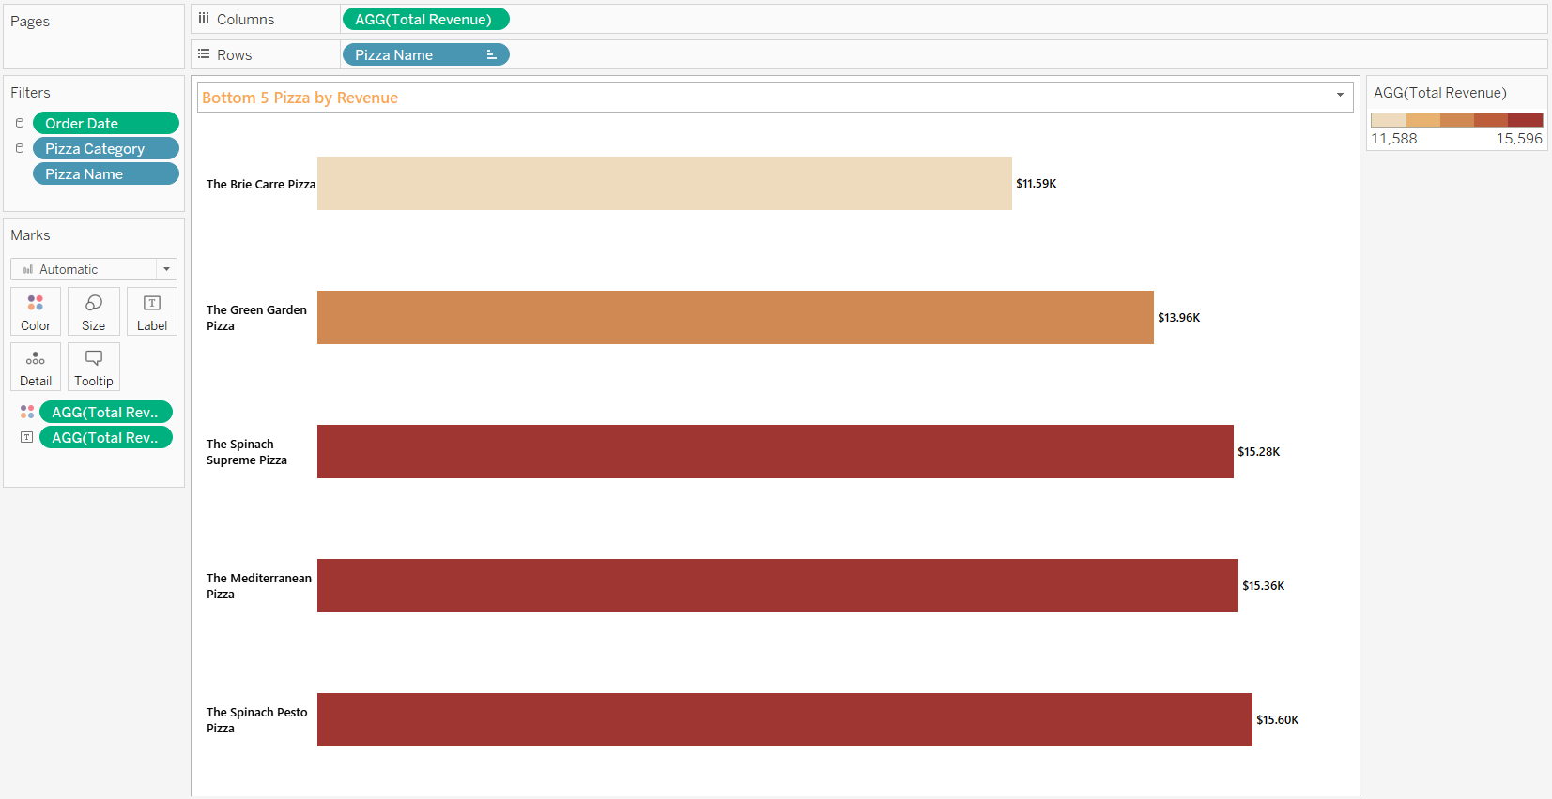
Bottom 5 pizza by revenue

Slide 43
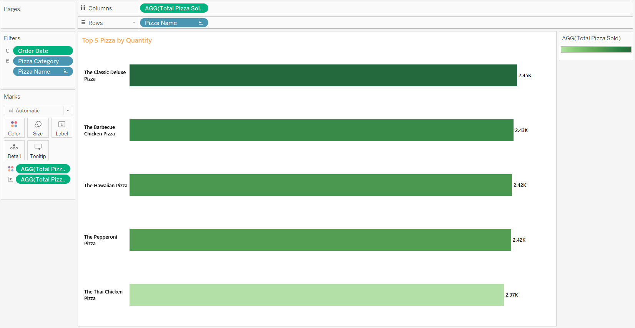
Top 5 pizza by Quantity

Slide 44
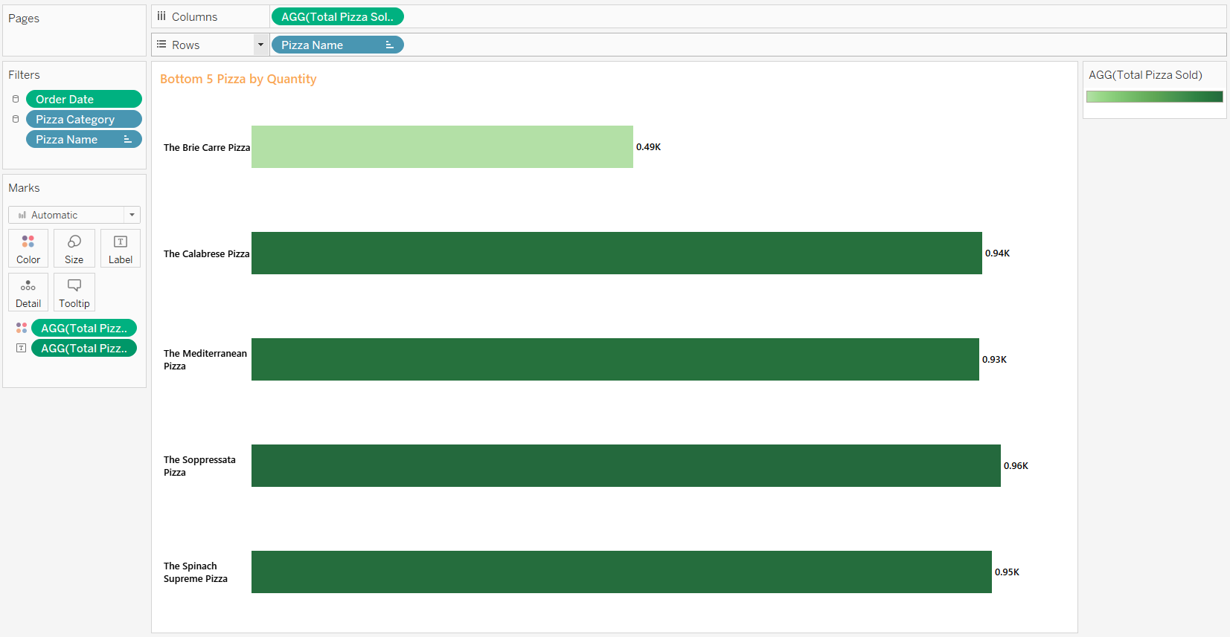
Bottom 5 pizza by Quantity

Slide 45
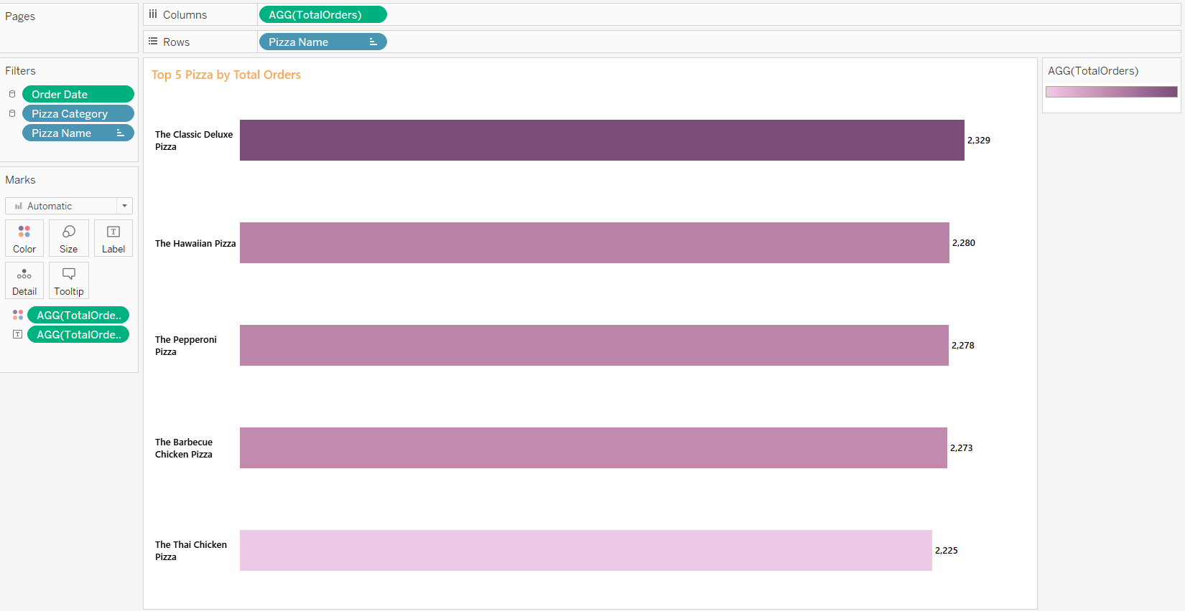
Top 5 pizza by Total Orders

Slide 46
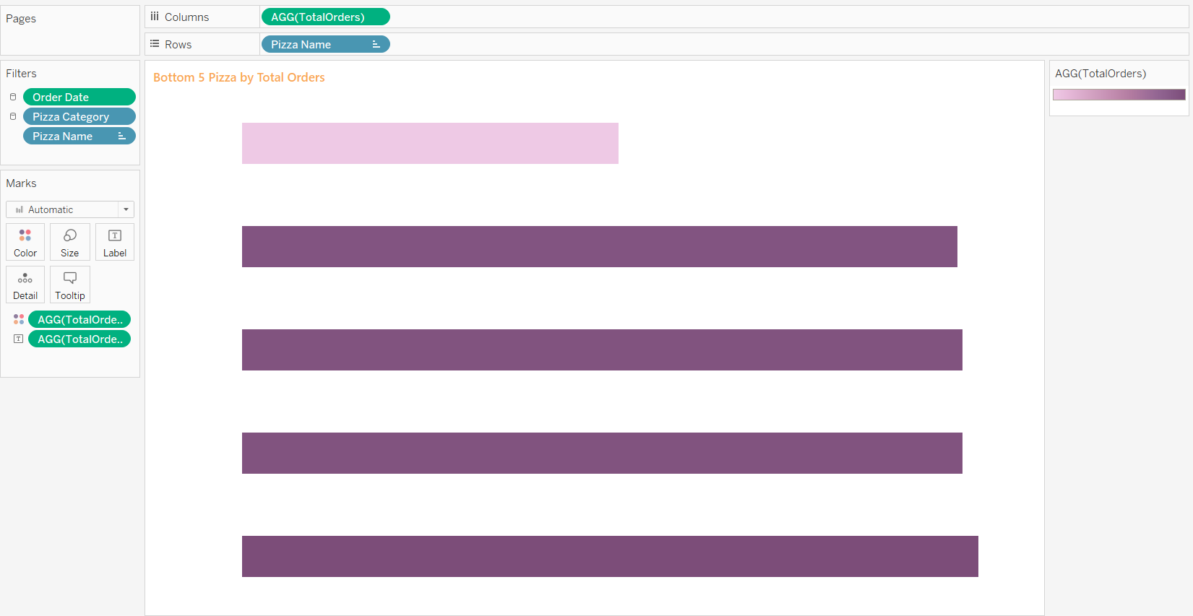
Bottom 5 pizza by Total Orders

Slide 47
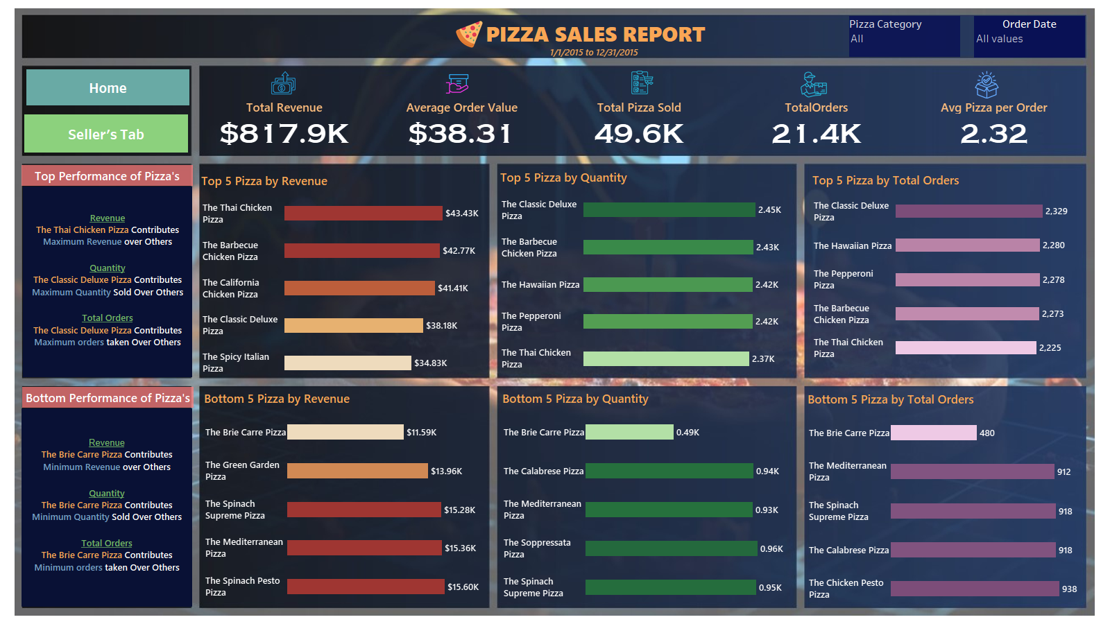
Final Output

Slide 48
Data Findings
Rush Hours & Weeks
Hours
Peak orders are Between 12:00 PM to 1.00 PM, and in evening start at 4.00 Pm to 7.00 PM
Weeks
Significant Variations in Weekly orders, with highest peak during the 4th week from the month of Dec
Sales Performance
Category
Classic Category Contribute to Maximum Sales, total orders & Total Pizza Sold
Size
Large Pizza Size Contributes to Maximum Total Sales

Slide 49
Data Findings
Rush Hours & Weeks
Revenue
The Thai Chicken Pizza Contributes Maximum Revenue over Others
Quantity
The Classic Deluxe Pizza Contributes Maximum Quantity Sold Over Others
Total Orders
The Classic Deluxe Pizza Contributes Maximum orders taken Over Others
Sales Performance
Revenue
The Brie Carre Pizza Contributes Minimum Revenue over Others
Quantity
The Brie Carre Pizza Contributes Minimum Quantity Sold Over Others
Total Orders
The Brie Carre Pizza Contributes Minimum orders taken Over Others

Slide 50
Thank You

